Slide 1
Neighbourhood Development Plan
Lympstone 2019 to 2031

Slide 2
Outline
Where we came from :-
Started 2012 - Made 2014 19 month gestation (longer than Elephant)
First in EDDC – “all” parishes following – encouraged by EDDC as a part of The Local Plan
Time for review :-
NPPF dictates that a NDP must be “reviewed” every 5 years
Exeter Strategic Plan due for first release in May/June
Demands even more houses across all area
Currently 1,000 pa for East Devon (West)
Plan looking “woolly” as policies become out of date and objectives achieved
Need for greater emphasis on areas shown to be weak
Successes :-
Courtlands lane development stopped
Green wedge maintained
Housing target achieved in 4 years
Broadband in most homes at 20mg (from 2 – if you were lucky)
Exeter Trail – progress
Flood Resilience Group formed

Slide 3
Outline
Lympstone Delivered EARLY
65/40
Credibility
Confidence to deliver
Leaders in East Devon

Slide 4
BUT
Less than 6 young families were either granted Social Housing or were able to afford “Affordable” housing.
Affordable Housing is a nonsense in Lympstone
4 luxury houses with a sales price in excess of £1.4m and a further plot with planning permission at £0.5m.
Since they are all “self-build” the Community do not even benefit from the CiL.
We have failed to provide housing for our youth.
Since 2001 despite a growing aged population no homes have been built specifically to serve this section of our community.
There are too many elderly people living in homes built for families because they cannot find small, easily manged and modern homes in our Community.
We have failed another sector of our Community.

Slide 5
Overarching View
Section 1 - Housing development
Section 2 - Environmental Sustainability
Section 3 - Economic Sustainability
Section 4 - Social Sustainability
Section 5 - Getting Around
Section 6 - Flooding & Water Management

Slide 6
Housing
Development
Goodmore’s Farm – it WILL happen (one day)
What do our Community want from it?
CIL and it’s use
Industrial units
Allocation of housing
Primary school
Football/Cricket Pitch
Footpaths
No extension to BuAb?
Do we need more housing?
Have we met the housing needs of our Community?
Type and purpose
Community Led
Enforce more strongly the Green Wedge?
How?
Loss of Lympstone heritage – but not G1 or G2
Extension of bungalows

Slide 7
Environmental
Sustainability
East Devon is acknowledged as one of the top recyclers in the UK. In 2019 they are introducing a new scheme to encourage the re-cycling of cardboard having introduced garden waste in 2018. What can Lympstone do to assist the waste initiative?
Deadlines ARE coming
Government action has enabled Communities easier planning rights for installing renewable energy supplies.
Solar/Wind or ???
Would you like to see a non-aligned presentation on non-fossil fuel energy delivery?
Would you support a policy for solar panels on all new developments or extensions?
What other initiatives would you like to make on Environmental Sustainability?

Slide 8
Economic
Sustainability
Goodmore’s Farm Units
Home working?
Your ideas
What can we do to support or initiate

Slide 9
The new PH Strategic Plan 2019-23 (EDDC)- to identify the value of public health work => East Devon’s Public Health Implementation Plan 2020/21
“Care in the Community” and NHS Strategy
What effect on us?
How can we contribute?
Clubs & Societies
Changes in Retailing
“Loneliness is the epidemic disease of the 21st Century” - Discuss
What can we do assist?
Any ideas or thoughts?
Does that answer many of the queues at the surgery?
Sustain our Pre-School, Primary School and Youth Club
Social
Sustainability
We have an aging population in Lympstone with 24% of our population over 65 – higher than most communities in East Devon – and growing.

Slide 10
Exe Estuary Trail
Progress
Dinan Way extension
Will, at £12m, it ever happen?
Flood Resiliance
Parking is it a problem?
Any solution seems to cause aggravation elsewhere in Lympstone
Available land
Speeding
New footpaths
From married quarters on New Road
Any others?
Car Share
Getting Around

Slide 11
Flooding
Sewerage
Flooding & Water Management

Slide 12
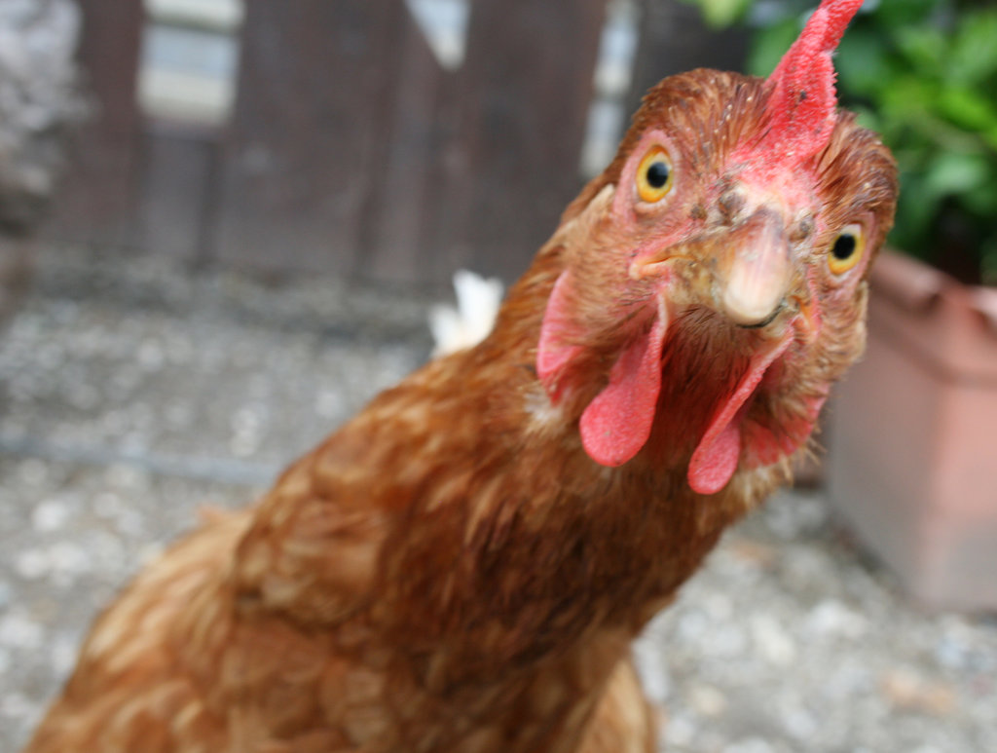
Housing
Development
Environmental
Sustainability
Economic
Sustainability
Our Golden Eggs (and a chicken!)
Social
Sustainability
Getting Around
Flooding & Water Management

Slide 13
The Lympstone Rocket

Slide 14
The Lympstone Rocket
“You can control your future and your destiny. What you think about comes about. By recording your dreams and goals on paper, you set in motion the process of becoming the person you most want to be. Put your (Community’s) future in good hands - your own.”
Mark Victor Hansen

Slide 15
Email any comments, thoughts and ideas to:
lympstonepc@gmail.com

